Slide 1
ETHERNET

Slide 2
What is Ethernet?
Very popular cabling technology
A local-area network (LAN) protocol developed by Xerox
Ethernet is a network protocol that controls how data is transmitted over a LAN.
IEEE 802.3 specification

Slide 3
Ethernet uses a bus or star topology and supports data transfer rates of 10/100/1000 Mbps
Ethernet uses the CSMA/CD access method to handle simultaneous demands.
Ethernet defines the lower two layers of the OSI Reference Model

Slide 4
How does Ethernet work?
Ethernet transmits frames of data across baseband cables using CSMA/CD (IEEE 802.3) using MAC addresses to distinguish between machines.
Datalink layer is divided into LLC and MAC.

Slide 5
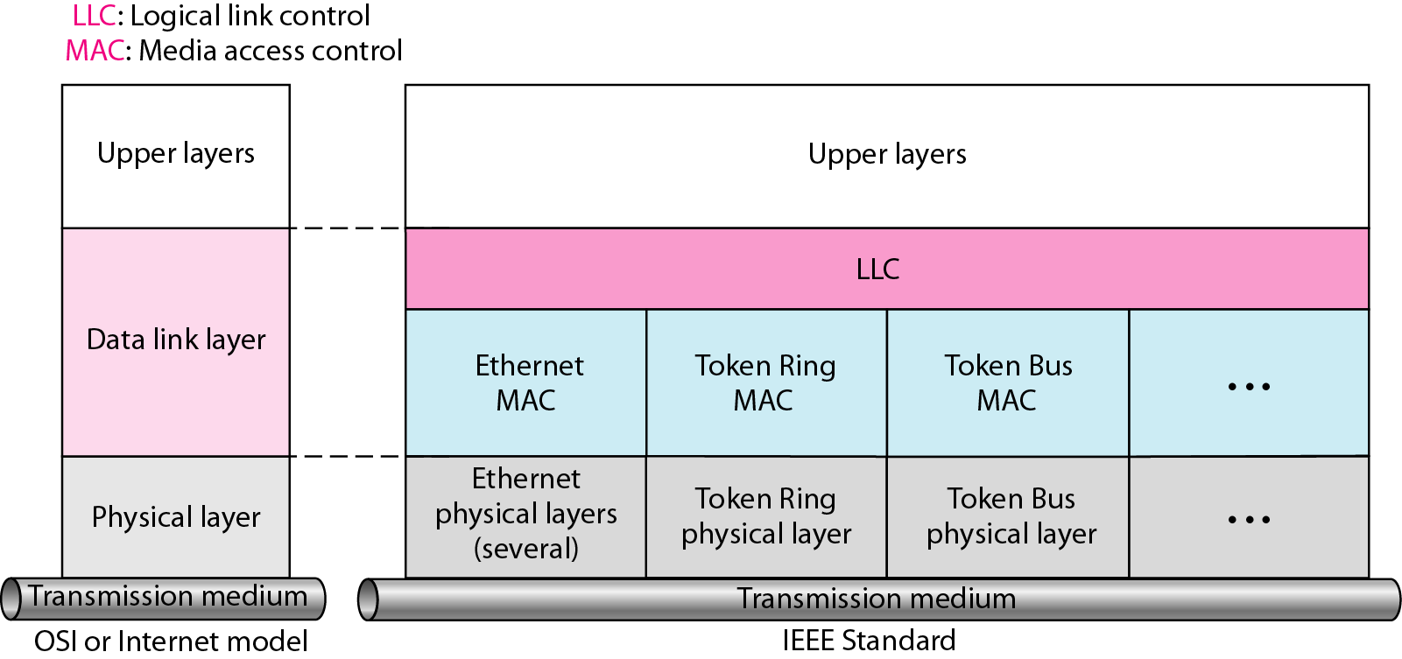
IEEE standard for LANs

Slide 6
MAC Address
Media Access Control Address
Physical address of any device, e.g. a NIC in a computer on the network.
6 bytes long.
first 3 bytes specify the company that made the NIC
the second 3 bytes -serial number of the NIC.

Slide 7
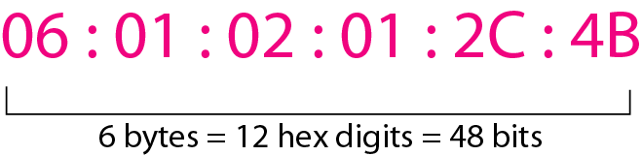
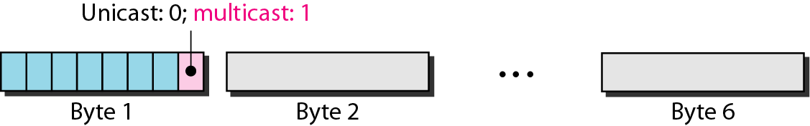
Example of an Ethernet address in hexadecimal notation

Slide 8
The least significant bit of the first byte defines the type of address. If the bit is 0, the address is unicast; otherwise, it is multicast.
The broadcast destination address is a special case of the multicast address in which all bits are 1s.

Slide 9
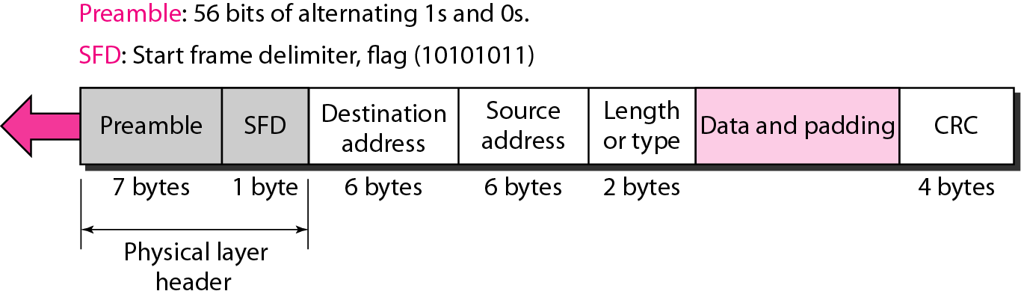
802.3 Ethernet frame format

Slide 10
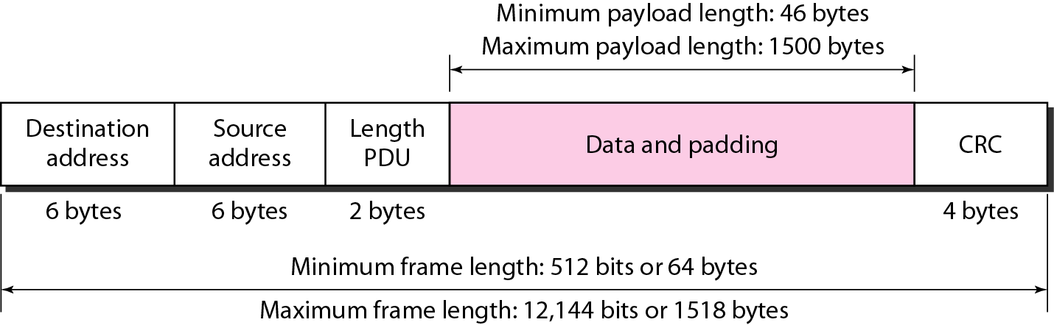
Minimum and maximum lengths

Slide 11
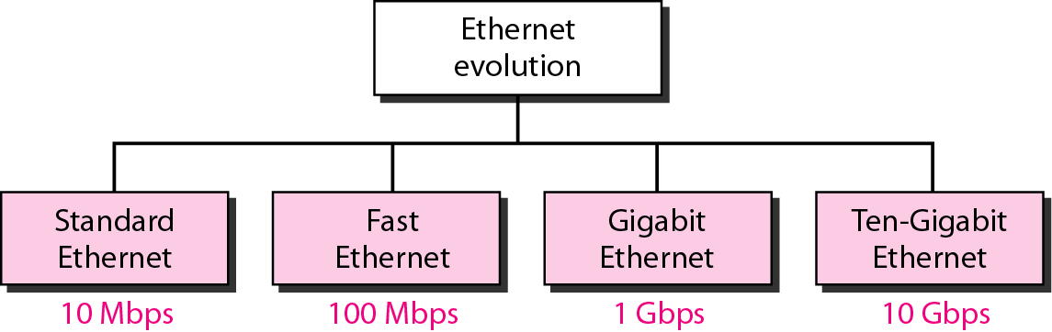
Ethernet Evolution

Slide 12
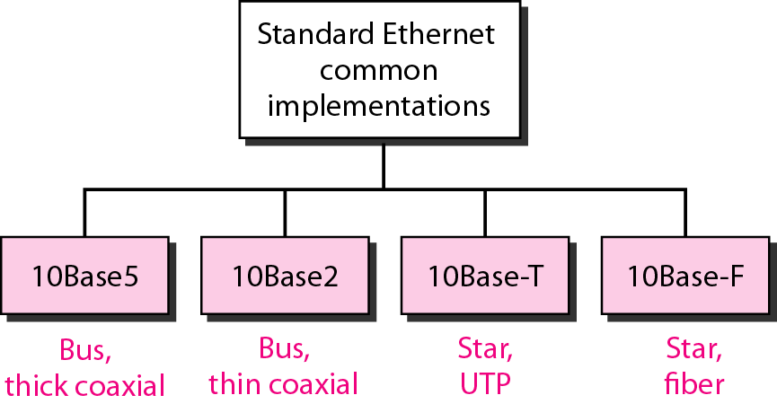
Categories of Standard Ethernet

Slide 13
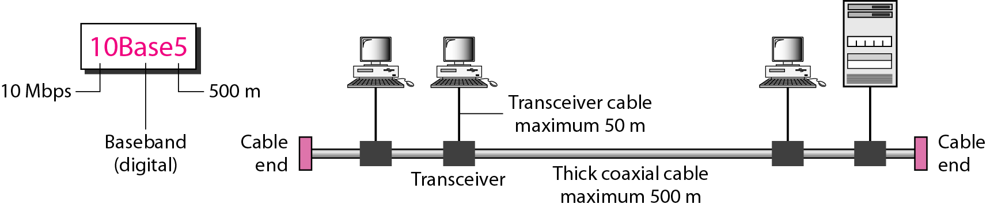
10Base5 implementation

Slide 14
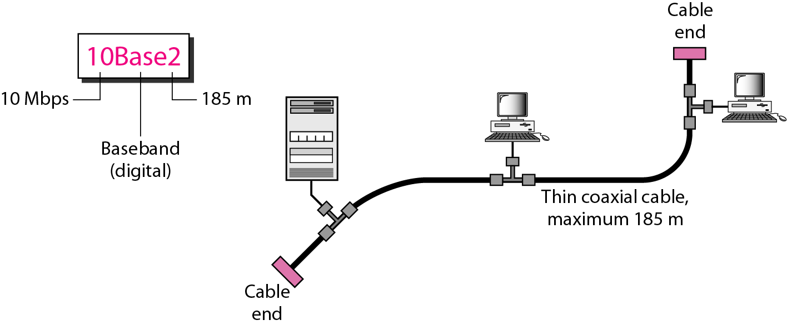
10Base2 implementation

Slide 15
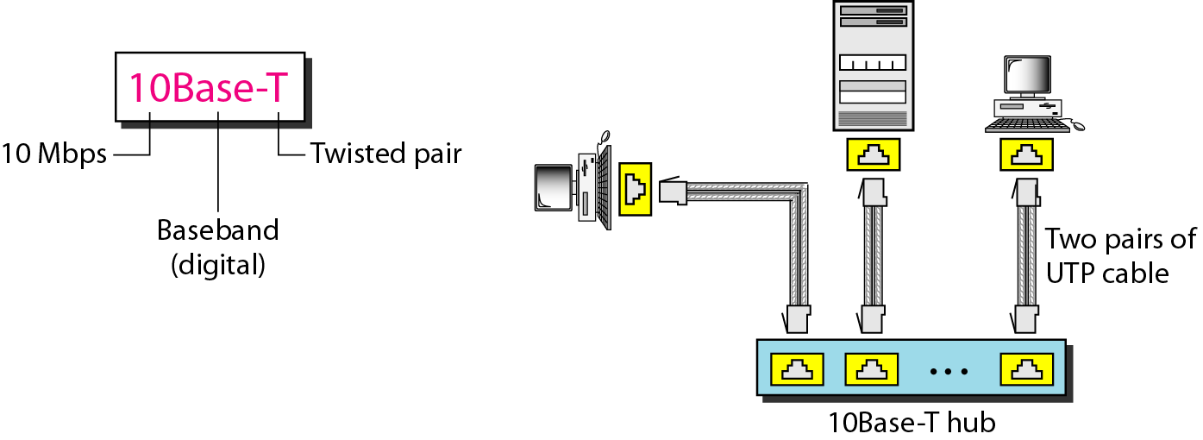
10BaseT implementation

Slide 16
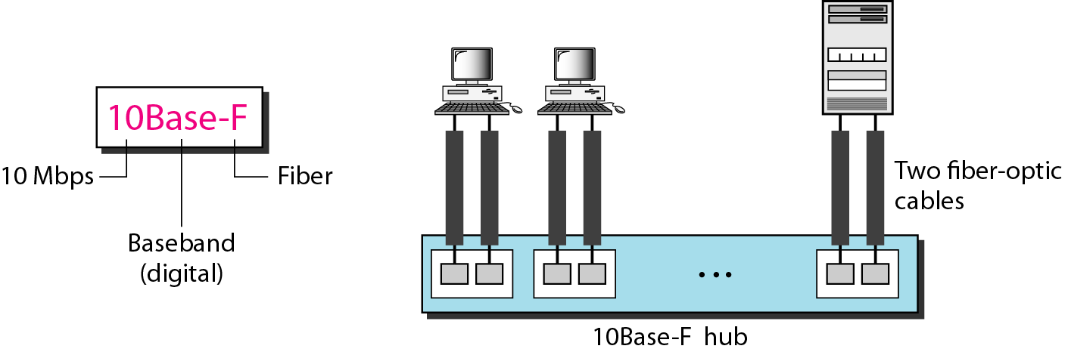
10BaseF implementation

Slide 17
Summary-Standard Ethernet

Slide 18
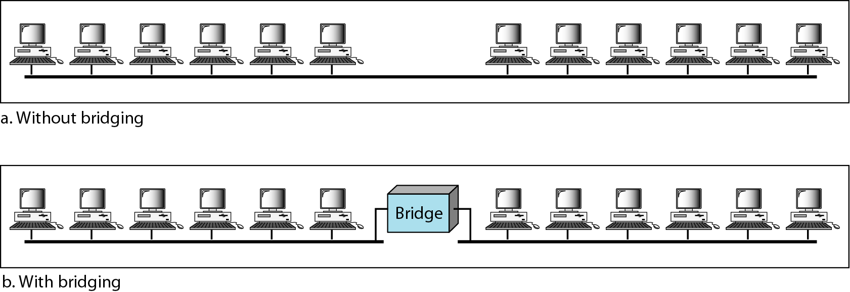
Bridged Ethernet

Slide 19
2 effects of bridges-
Raising the bandwidth
Bridge divides the network .
Bandwidth-wise each network is independent
Separation of collision domains
Smaller domains
Probability of collision reduced

Slide 20
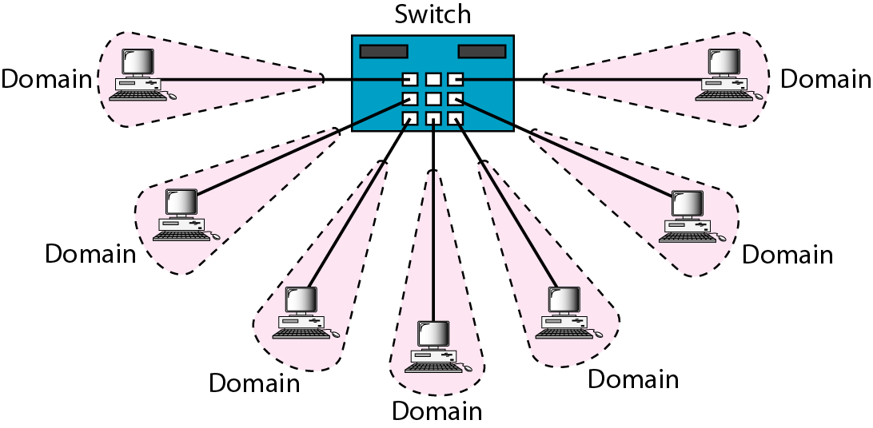
Switched Ethernet

Slide 21
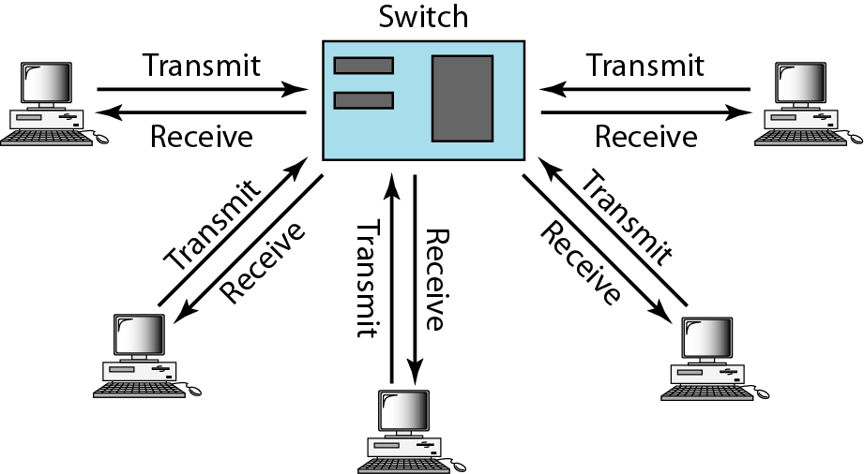
Full-duplex switched Ethernet

Slide 22
Fast Ethernet
Newer version of Ethernet-802.3u
Compete with LAN protocols such as FDDI or Fiber Channel
Backward-compatible
Bandwidth - 100 Mbps
Uses Cat5 or greater cable
-Sometimes called 100Base T
Star topology.

Slide 23
Autonegotiation
Allows two devices to negotiate the mode or data rate of operation.
To allow-
Incompatible devices to connect to one another.
One device to have multiple capabilities.
A station to check a hub’s capabilities.

Slide 24
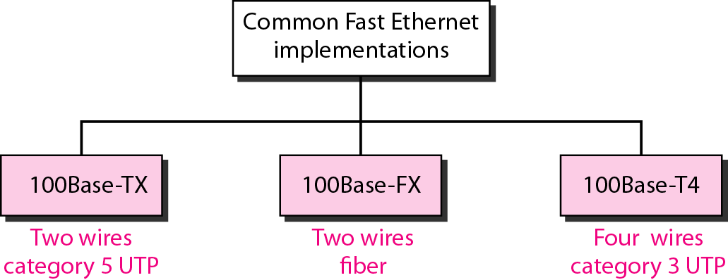

Slide 25
Gigabit Ethernet
IEEE802.3z
Bandwidth-1000Mbps
Compatible with Standard and Fast Ethernet.
Support autonegotiation as in fast Ethernet.
Mostly follows full duplex approach.

Slide 26
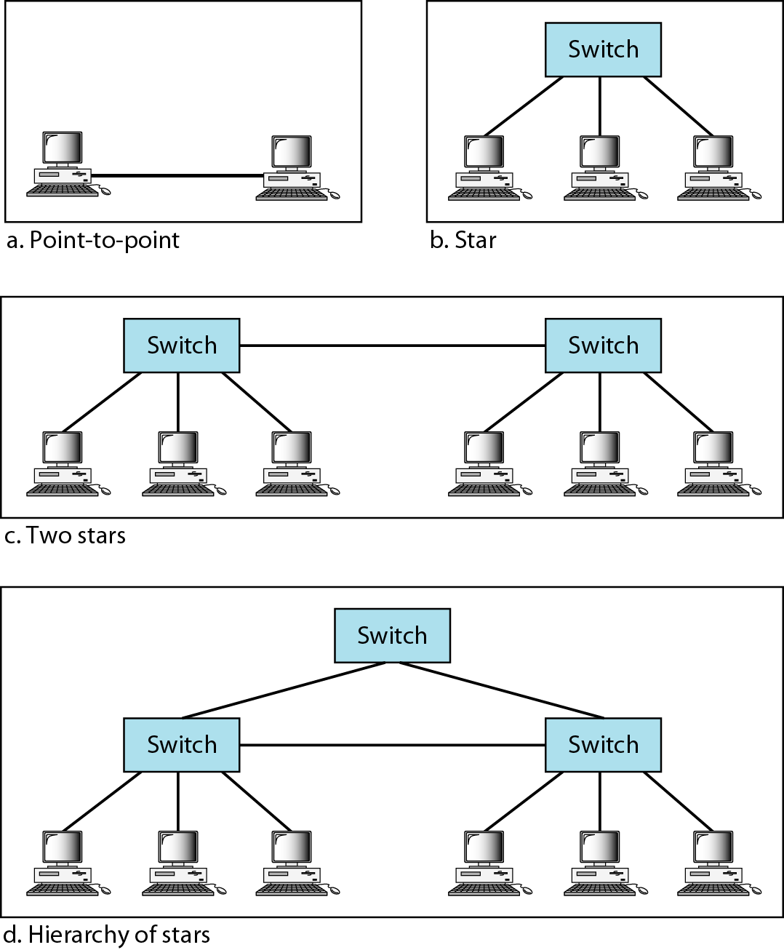
Topologies of Gigabit Ethernet

Slide 27
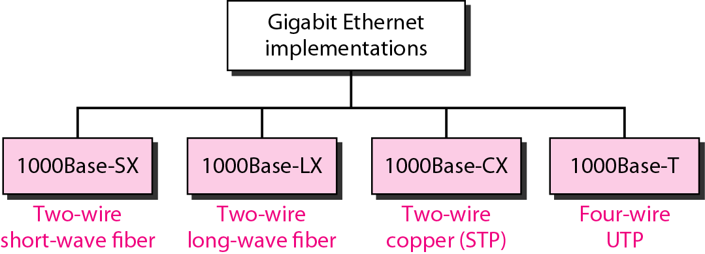

Slide 28
Thank You

